Slide 1
Process Management
Unit_2

Slide 2
Process
A process is a program in execution.
For example, when we write a program in C and compile it, the compiler creates binary code. The original code and binary code are both programs. When we actually run the binary code, it becomes a process.
A process is an 'active' entity as opposed to the program which is considered to be a 'passive' entity.

Slide 3
Process memory is divided into four sections for efficient working :
The Text section is made up of the compiled program code, read in from non-volatile storage when the program is launched.
The Data section is made up of the global and static variables, allocated and initialized prior to executing the main.
The Heap is used for the dynamic memory allocation and is managed via calls to new, delete, malloc, free, etc.
The Stack is used for local variables. Space on the stack is reserved for local variables when they are declared.

Slide 4
Process States
The state of a process is defined by the current activity of the process.
The process executes when it changes the state.
Each process may be in any one of the following states −
New − The process is being created.
Running − In this state the instructions are being executed.
Waiting − The process is in waiting state until an event occurs like I/O operation completion or receiving a signal.
Ready − The process is waiting to be assigned to a processor.
Terminated − the process has finished execution.

Slide 5
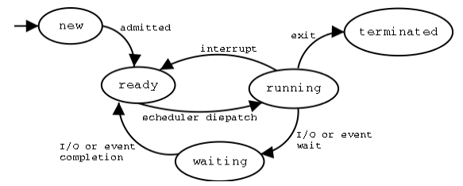

Slide 6
Step 1 − Whenever a new process is created, it is admitted into ready state.
Step 2 − If no other process is present at running state, it is dispatched to running based on scheduler dispatcher.
Step 3 − If any higher priority process is ready, the uncompleted process will be sent to the waiting state from the running state.
Step 4 − Whenever I/O or event is completed the process will send back to ready state based on the interrupt signal given by the running state.
Step 5 − Whenever the execution of a process is completed in running state, it will exit to terminate state, which is the completion of process.

Slide 7
Process Control Block (PCB)
Process Control Block is a data structure that contains information of the process related to it.
The process control block is also known as a task control block.
While creating a process the operating system performs several operations.
To identify the processes, it assigns a process identification number (PID) to each process.
As the operating system supports multi-programming, it needs to keep track of all the processes.
For this task, the process control block (PCB) is used to track the process’s execution status.

Slide 8
Each block of memory contains information about the process state, program counter, stack pointer, status of opened files, scheduling algorithms, etc.
All this information is required and must be saved when the process is switched from one state to another.
When the process makes a transition from one state to another, the operating system must update information in the process’s PCB.

Slide 9
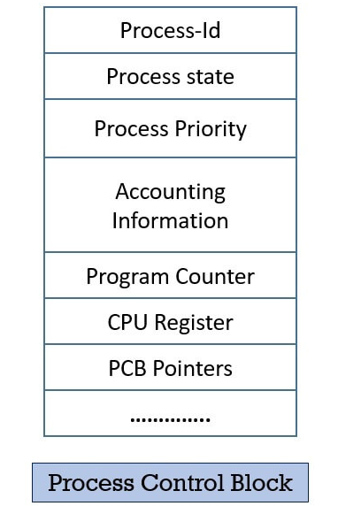
Structure of the Process Control Block

Slide 10
Process-id
Process State
Process Priority: The priority of the process can be assigned externally by the user or by the operating system itself. The process is assigned the priority at the time of its creation. The priority of the process may get changed over its lifetime.
Process Accounting Information: This field of PCB gives the account/description of the resources used by that process. Like, the amount of CPU time, real-time used, connect time.
Program Counter: The program counter is the pointer to an instruction in the program or code that is to be executed next. This field contains the address of the instruction that will be executed next in the process.

Slide 11
List of Open Files
Process I/O status Information: Sometimes the process executing in the system require I/o devices. So, this field of PCB contains the list of all the I/O devices allocated to the process during its execution.
CPU Registers: Whenever an interrupt occurs and there is a context switch between the processes, the temporary information is stored in the registers. So, that when the process resumes the execution it correctly gains from where it leaves. CPU registers are used to hold those temporary values or information.

Slide 12
Threads:
A thread is the smallest unit of processing that can be performed in an OS.
In most modern operating systems, a thread exists within a process - that is, a single process may contain multiple threads.
Threads, like process, are a mechanism to allow a program to do more than one thing at a time.
Conceptually, a thread (also called lightweight process) exists within a process (heavyweight process).

Slide 13
Example of thread
Word processor that may have a thread for displaying the UI or graphics while a new thread for responding to keystrokes received from the user and another thread is to perform spelling and grammar checking in the background.

Slide 14
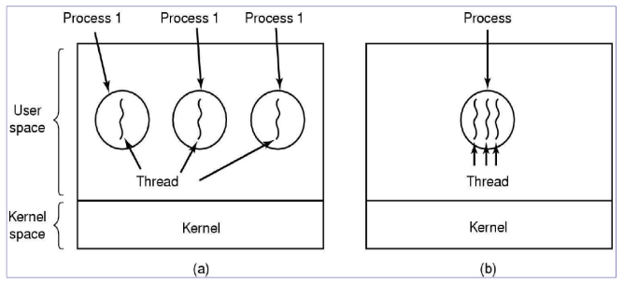

Slide 15
In fig (a), we see three traditional processes.
Each threads has its own address space and a single thread of control.
The term multithreading is used to describe the situation of allowing the multiple threads in same process as shown in figure (b),
When multithreaded process is run on a single-CPU system, the threads take turns running as in the multiple processes.
All threads share the same address space, global variables, set of open file, child processes, alarms and signals etc.

Slide 16
Types of Threads
In the operating system, there are two types of threads:
Kernel level thread.
User-level thread.

Slide 17
User-level thread
The operating system does not recognize the user-level thread.
User threads can be easily implemented and it is implemented by the user.

Slide 18
Kernel level thread
The kernel thread recognizes the operating system.
There is a thread control block and process control block in the system for each thread and process in the kernel-level thread.
The kernel-level thread is implemented by the operating system.
The kernel knows about all the threads and manages them.
The kernel-level thread offers a system call to create and manage the threads from user-space.
The implementation of kernel threads is more difficult than the user thread.

Slide 19
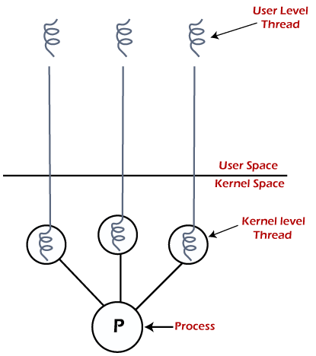

Slide 20
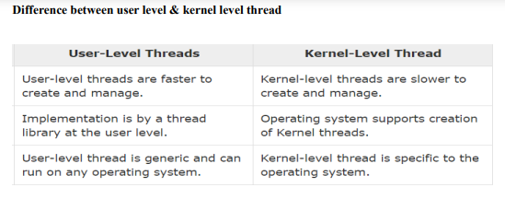

Slide 21
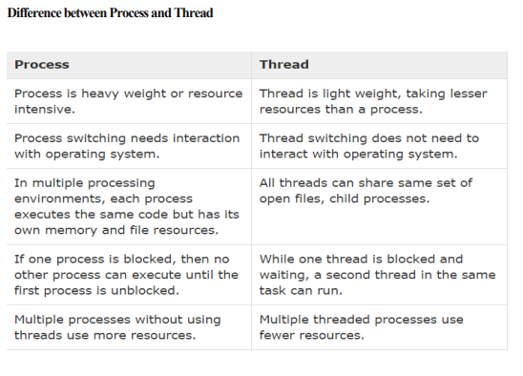

Slide 22
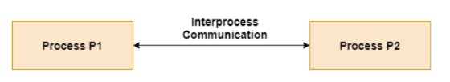
Inter process Communication(IPC)
The mechanism of passing information from one process to another process is called IPC.
Processes frequently need to communicate with other processes.
There are two models of IPC: Message passing and Shared memory.

Slide 23
Inter process Communication(IPC)
Real-time multiplayer gaming is a prime example of inter-process communication.
In such games, multiple players interact in the same virtual environment simultaneously, requiring constant communication between their devices and the game server to synchronize actions and updates in real-time.
Each player's device communicates with the server to send their inputs (e.g., movements, actions) and receive updates (e.g., positions, scores) from other players, ensuring a seamless and synchronized gaming experience across all participants.

Slide 24
Inter process Communication(IPC)
Processes executing concurrently in the operating system may be either independent
processes or cooperating processes.
Independent Process: Any process that does not share data with any other process. An
Independent process does not affect or be affected by the other processes executing in the
system.
Cooperating Process: Any process that shares data with other processes. A cooperating
process can affect or be affected by the other processes executing in the system.
Cooperating processes require an Inter-Process Communication (IPC) mechanism that
will allow them to exchange data and information.

Slide 25
Real-world examples of inter-process communication (IPC)
Web Servers: Web servers use IPC mechanisms like sockets to handle multiple client requests concurrently.
Graphics Processing: In graphical user interfaces (GUIs), IPC is often used to communicate between different processes responsible for managing the user interface, rendering graphics, and handling user input.
Databases: Database management systems (DBMS) use IPC for communication between different components such as the database server, query optimizer, transaction manager, and storage engine.

Slide 26
Real-world examples of inter-process communication (IPC)
Multimedia Applications: Multimedia applications like video players and audio editors often use IPC to synchronize playback, manage streams, and communicate with hardware devices. For example, in a video editing software, the user interface process communicates with the video decoding process using shared memory or message passing to display the video frames in real-time.
Distributed Systems: In distributed systems, IPC is used for communication between processes running on different machines over a network. For instance, in a distributed file system, a client process communicates with file servers using IPC mechanisms like remote procedure calls (RPC) or sockets to perform file operations such as read, write, and delete.

Slide 27
Message-Passing System
A Message-Passing System is a mechanism within an operating system that allows processes to communicate by sending and receiving messages. Here's an overview of how it works and some examples:
Message Passing Mechanism:
Send: A process can send a message to another process by calling a system-provided function or system call.
Receive: A process can receive a message from another process by waiting for a message or by actively checking for messages.

Slide 28
Message-Passing System
Synchronous vs. Asynchronous Communication:
Synchronous: In synchronous communication, the sender blocks until the receiver acknowledges receipt of the message.
Asynchronous: In asynchronous communication, the sender continues its execution after sending the message without waiting for a response from the receiver.
Types of Message Passing Systems:
Direct Communication: Processes must explicitly name the recipient or sender of the message.
Indirect Communication: A message is sent to a mailbox or port, and processes can communicate indirectly through these mailboxes without knowing each other's identity.

Slide 29
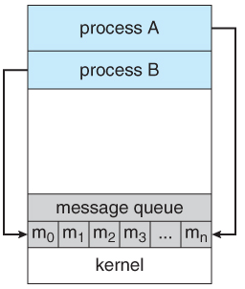
Message-Passing System
In the message-passing model, communication takes place by means of messages exchanged between the cooperating processes.
Message passing provides a mechanism to allow processes to communicate and to synchronize their actions without sharing the same address space.
It is particularly useful in a distributed environment, where the communicating processes may reside on different computers connected by a network.
A message-passing facility provides two operations: send, receive.
Messages sent by a process can be either fixed or variable in size.
Example: An Internet chat program could be designed so that chat participants communicate with one another by exchanging messages

Slide 30
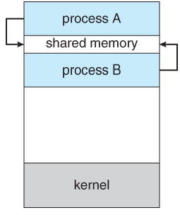
Shared Memory Systems
Shared Memory Systems in operating systems allow multiple processes to share a portion of memory.
In the shared-memory model, a region of memory will be shared by cooperating processes.
Processes can exchange information by reading and writing data to the shared region.
A shared-memory region (segment) resides in the address space of the process.
Other processes that wish to communicate using this shared-memory segment must attach it to their address space.

Slide 31
Examples:
Database Management Systems (DBMS): DBMS often use shared memory for interprocess communication between different components of the system, such as the query processor, transaction manager, and storage engine. For example, PostgreSQL uses shared memory to share data structures like the buffer pool and lock table among its processes.
Parallel Computing: Shared memory systems are widely used in parallel computing environments to facilitate communication and data sharing among parallel processes or threads. For instance, OpenMP, a popular API for parallel programming, allows threads to access shared data in memory.
Multithreaded Applications: In multithreaded applications, threads within the same process can communicate and synchronize with each other using shared memory. For example, in a web server handling multiple client requests concurrently, threads may use shared memory to access a shared cache of frequently accessed resources.

Slide 32
Process Synchronization
Process synchronization in operating systems refers to the coordination and control of multiple processes to ensure that they cooperate with each other correctly when accessing shared resources or executing concurrently.

Slide 33
Process Synchronization
When multiple processes execute concurrently sharing system resources, then inconsistent results might be produced.
Process Synchronization is a mechanism that deals with the synchronization of processes.
It controls the execution of processes running concurrently to ensure that consistent results are produced.
Need of Synchronization-
Process synchronization is needed-
When multiple processes execute concurrently sharing some system resources.
To avoid the inconsistent results.

Slide 34
Techniques used in Process Synchronization:
Mutual Exclusion:
Deadlock Prevention and Avoidance:
Condition Synchronization:
Producer-Consumer Problem:
Reader-Writer Problem:

Slide 35
Race Condition
The situation where, two or more processes are reading or writing some shared data and the result depends on who runs precisely when, is called as a race condition.
Our objective is to avoid race condition.
How to Avoid race condition?

Slide 36
Shared Resource Access:
Race conditions often arise in scenarios where multiple processes or threads concurrently access shared resources such as variables, data structures, or hardware devices.
If these accesses are not properly synchronized, the outcome may depend on the order or timing of these accesses, leading to unpredictable or incorrect behavior.

Slide 37
Example: Ticket Reservation System
Imagine a simple ticket reservation system where multiple users can reserve tickets for an event. Each ticket has a unique identifier, and the system tracks the number of available tickets.
In this example, each user is represented by a thread trying to reserve a ticket. However, due to the race condition, multiple threads may simultaneously check the availability of tickets before updating the available_tickets variable. This can result in the available_tickets variable being decremented below zero, allowing more tickets to be reserved than actually available.
To prevent this race condition, synchronization mechanisms such as locks or semaphores should be used to ensure that only one thread can access the critical section (updating the available_tickets variable) at a time.

Slide 38
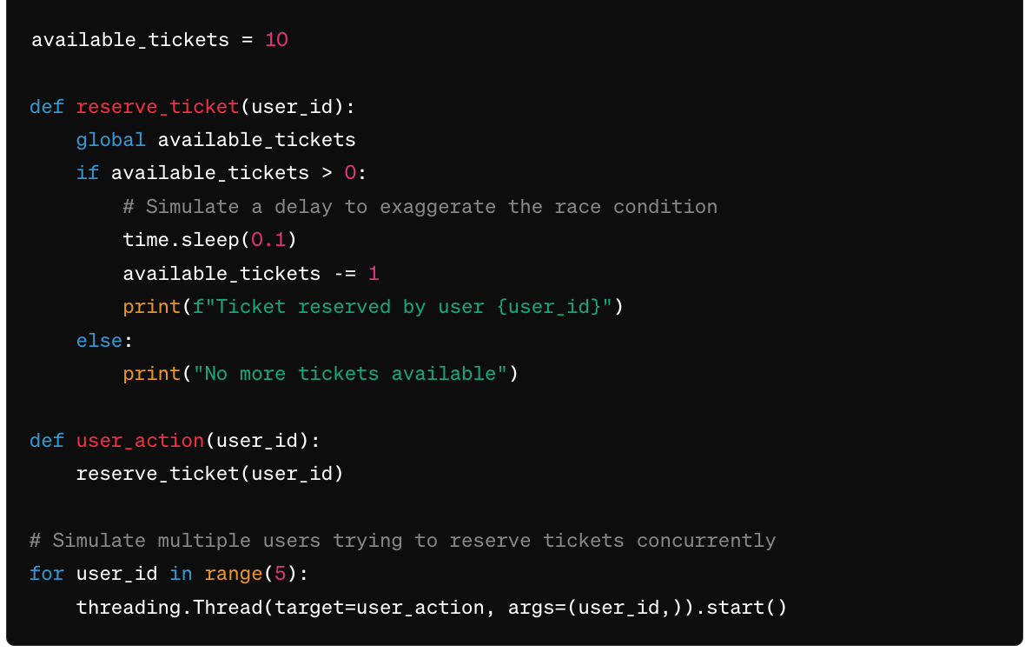

Slide 39
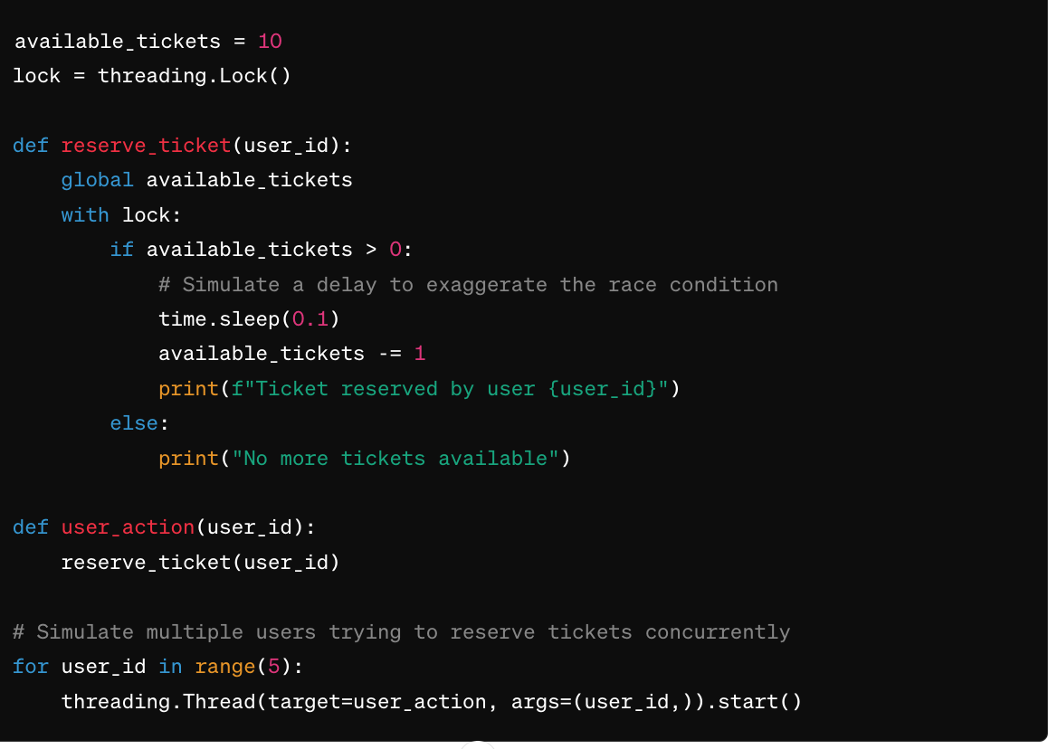
With the lock, only one thread can execute the critical section at a time, ensuring that the available_tickets variable is updated correctly and preventing race conditions.

Slide 40
Critical Section-
Critical section is a section of the program where a process access the shared resources during its execution.
If we could arrange such a way that no two processes were ever in their critical regions at the same time, we could avoid race conditions.

Slide 41
Mutual exclusion
When a process is executed in a critical section, then no other process can be executed in their critical section
We need four conditions to hold to have a good solution for race condition:
No two processes may be simultaneously inside their critical regions.
No assumptions may be made about speeds or number of CPUs.
No process running outside its critical region may block other processes.
No process should have to wait forever to enter its critical region.

Slide 42
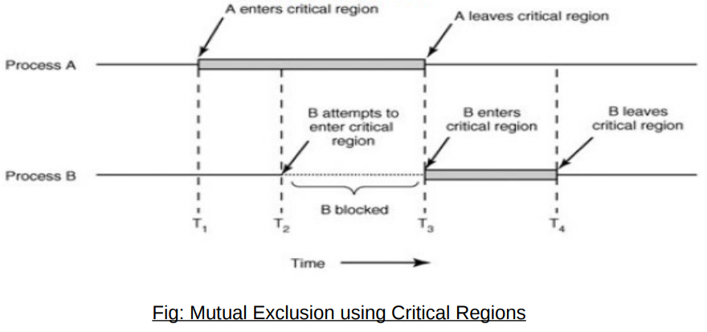
Here process A enters its critical region at time T1 . A little later, at time T 2 process B attempts to enter its critical region but fails because another process is already in its critical region and we allow only one at a time. Consequently, B is temporarily suspended until time T 3 when A leaves its critical region, allowing B to enter immediately. Eventually B leaves (at T 4 ) and we are back to the original situation with no processes in their critical regions.

Slide 43
Mutual exclusion: Lock Variable
This is the simplest synchronization mechanism. This is a Software Mechanism implemented in User mode. This is a busy waiting solution which can be used for more than two processes.
In this mechanism, a Lock variable lock is used. Two values of lock can be possible, either 0 or 1. Lock value 0 means that the critical section is vacant while the lock value 1 means that it is occupied.
A process which wants to get into the critical section first checks the value of the lock variable. If it is 0 then it sets the value of lock as 1 and enters into the critical section, otherwise it waits.
The pseudo code of the mechanism looks like following:
Entry Section →
While (lock! = 0);
Lock = 1;
//Critical Section
Exit Section →
Lock =0

Slide 44
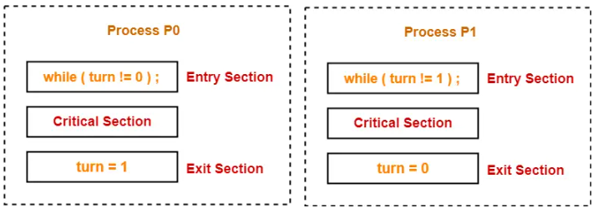
Mutual exclusion: Strict Alternation Approach
Strict Alternation Approach is the software mechanism implemented at user mode. It is a busy waiting solution which can be implemented only for two processes. In this approach, A turn variable is used which is actually a lock.
In strict alternation approach,
Processes have to compulsorily enter the critical section alternately whether they want it or not.
This is because if one process does not enter the critical section, then other process will never get a chance to execute again.
Initially, turn value is set to 0.
Turn value = 0 means it is the
turn of process P₀ to enter the
critical section.
Turn value = 1 means it is the
turn of process P₁ to enter the
critical section.

Slide 45
Mutual exclusion: Peterson's solution
Peterson's solution ensures mutual exclusion.
It is implemented in user mode and no hardware support is required therefore it can be implemented on any platform.
Peterson’s solution uses two variables: interest and Turn variable.
#define N 2
#define TRUE 1
#define FALSE 0
int interested[N]=False
int turn;

Slide 46
void Entry_Section(int process)
{
int other;
other=1-process
interested[process]= TRUE ;
turn = process;
while(interested[other]==TRUE && Turn=process);
}
void exit_section(int process)
{
interested[process]=FALSE;
}

Slide 47
Explanation
There will be two processes and the process number of the first process=0 and the process number of the second process is equal to 1.
So, if process 1 calls entry section then other = 1-process =1-1=0.
If process 0 calls then other = 1-process = 1-0 = 1
Now, since the process which called entry section it means that process want to execute a critical section then that process will set interested[process]=TRUE
So, if process 1 called entry section then interested[1]=TRUE
If process 0 is called entry section then interested[0]=TRUE
After declaring that process is interesting it will set its turn. So, if process 1 is called then turn =1.
Then, while (interested[other]==TRUE && Turn=process); will be executed.
In this line, the process checks whether other processes are interested or not. If that process is interested then interested[other]==TRUE will be true then the process thinks that it may happen that another process is executing the critical section.
For that, it will go into a loop until another process is not interesting. Now if another process becomes interested then interested[other]==TRUE
It will become False and the process will enter into a critical section. So, in this way, only one process may enter into the critical section. Therefore, mutual exclusion is guaranteed in Peterson's solution. While exiting the critical section process will set interest as False.

Slide 48
Semaphore
A semaphore is a synchronization construct in operating systems that allows multiple processes or threads to coordinate their activities when accessing shared resources.
It typically consists of a non-negative integer counter and two fundamental operations: wait (P) and signal (V).
Wait (P) operation: When a process or thread wants to access a shared resource protected by a semaphore, it performs a wait operation.
If the semaphore counter is greater than zero, the process can proceed, and the counter is decremented.
However, if the counter is zero, indicating that the resource is currently in use, the process is blocked until the semaphore counter becomes greater than zero.
Signal (V) operation: When a process or thread finishes using the shared resource, it performs a signal operation on the semaphore.
This operation increments the semaphore counter, indicating that the resource is now available.
If there are any processes waiting on the semaphore, one of them allowed to proceed.

Slide 49
There are two types of semaphores:
Binary Semaphore: Also known as a mutex (short for mutual exclusion), a binary semaphore has a counter that can only take the values 0 or 1.
It is used for mutual exclusion, ensuring that only one process or thread can access a shared resource at a time.
Counting Semaphore: A counting semaphore has a counter that can take non-negative integer values.
It is used to control access to a certain number of identical resources or to limit the number of concurrent processes or threads accessing a shared resource.
Counting semaphores are useful when multiple instances of a resource can be used simultaneously, up to a specified limit.

Slide 50
Classical IPC problems
In operating systems, IPC (Inter-Process Communication) refers to the mechanisms and techniques used by processes to communicate and synchronize with each other.
Classical IPC problems are a set of fundamental synchronization problems that highlight the challenges and solutions associated with coordinating the activities of concurrent processes.
The four classical IPC problems are:
The Producer-Consumer Problem
The Reader-Writer Problem
The Dining Philosophers Problem
Sleeping Barber Problem

Slide 51
Producers Consumer Problem
Producer-Consumer problem is a classic synchronization problem in concurrent programming, which involves two types of processes: producers and consumers.
The goal is to coordinate their activities and ensure that producers and consumers can operate concurrently without data inconsistencies or conflicts.
The problem is typically set in the context of a shared buffer or a bounded queue, which acts as a buffer between producers and consumers.
Producers generate data items and place them into the buffer, while consumers retrieve and consume those items.

Slide 52
The main challenge is to ensure that the following conditions are met:
Mutual Exclusion: Only one process (producer or consumer) can access the buffer at a time.
Full Buffer Condition: If the buffer is full, i.e., it has reached its maximum capacity, the producers should wait until there is space available in the buffer to add new items.
Empty Buffer Condition: If the buffer is empty, i.e., it does not contain any items, the consumers should wait until there are items available in the buffer to consume.

Slide 53
The Producer-Consumer problem can be solved using semaphores to synchronize the interactions between producers and consumers.
// Shared variables
buffer: shared data buffer
empty: semaphore indicating the number of empty slots in the buffer full: semaphore indicating the number of filled slots in the buffer mutex: semaphore for mutual exclusion
// Initialization
empty = n // Initialize empty semaphore with the size of the buffer
full = 0 // Initialize full semaphore to 0
mutex = 1 // Initialize mutex semaphore to 1

Slide 54
// Producer process
function producer:
while true:
item = produce_item() // Produce an item
down(empty) // Decrement empty semaphore down(mutex) // Enter critical section
insert_item(item) // Insert the item into the buffer up(mutex) // Exit critical section
up(full) // Increment full semaphore

Slide 55
// Consumer process
function consumer:
while true:
down(full) // Decrement full semaphore
down(mutex) // Enter critical section
item = remove_item() // Remove an item from the buffer up(mutex) // Exit critical section
up(empty) // Increment empty semaphore consume_item(item) // Consume the item

Slide 56
Reader-Writer problem
Reader-Writer problem is another classic synchronization problem in concurrent programming.
There are 2 types of users/process –
Readers – Reader are those processes/users which only read the data
Writers – Writers are those processes which also write, that is, they change the data .
It is allowed for 2 or more readers to access shared data, simultaneously as they are not making any change
But if one writer(Say w1) is editing or writing the file then it should locked and no other writer(Say w2) can make any changes until w1 has finished writing the file.
Writers are given to be exclusive access to shared database while writing to database. This is called Reader’s writer problem.

Slide 57
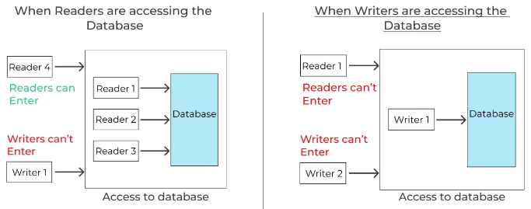
Highlights
If writer W1 has begun writing process then
No additional writer can perform write function
No reader is allowed to read
If 1 or more readers are reading then
Other readers may read as well
No writer may perform write function until all readers have finished reading

Slide 58
Dining Philosopher Problem
The Dining Philosophers problem is a classic synchronization problem in concurrent programming that illustrates the challenges of resource allocation and deadlock avoidance.
It is named after a scenario where a group of philosophers sits around a table and alternates between thinking and eating.
The philosophers share a limited number of forks that are placed between them.

Slide 59
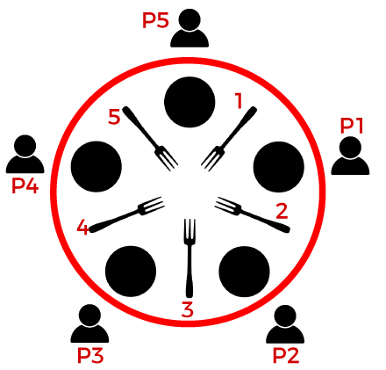
The problem can be stated as follows:
There are N philosophers sitting around a circular table, and each philosopher has a plate of spaghetti and a fork to the left and right of their plate.
A philosopher can be either thinking or eating. To eat, a philosopher must acquire both forks adjacent to them.
Each philosopher alternates between thinking and eating. They need two forks to eat, and they release the forks after they finish eating.
The challenge in the Dining Philosophers problem is to design a solution that prevents deadlock,

Slide 60
Sleeping Barber Problem
The Sleeping Barber problem is another classic synchronization problem in concurrent programming that models a scenario where customers arrive at a barbershop to get a haircut, while a barber performs the haircuts.
The problem focuses on coordinating the activities of customers and the barber to ensure that the barber is always cutting hair when there are customers and that customers wait when the barber is busy.

Slide 61
The problem can be described as follows:
There is a barbershop with a waiting room that has a limited number of chairs for customers to sit in while waiting for a haircut.
The barbershop has one barber who cuts hair. The barber has a chair for the customer to sit in during the haircut.
If a customer arrives at the barbershop and there is an available chair in the waiting room, they can sit down and wait for their turn. If all the chairs are occupied, the customer leaves.
When the barber finishes cutting a customer's hair, they check if there are any customers waiting in the waiting room. If there are, the barber invites the next customer to sit in the haircut chair. If there are no customers waiting, the barber goes to sleep in their chair.
The main objectives of the Sleeping Barber problem are:
Ensuring that customers are served in the order they arrive.
Avoiding deadlock where the barber or customers are waiting indefinitely.

Slide 62
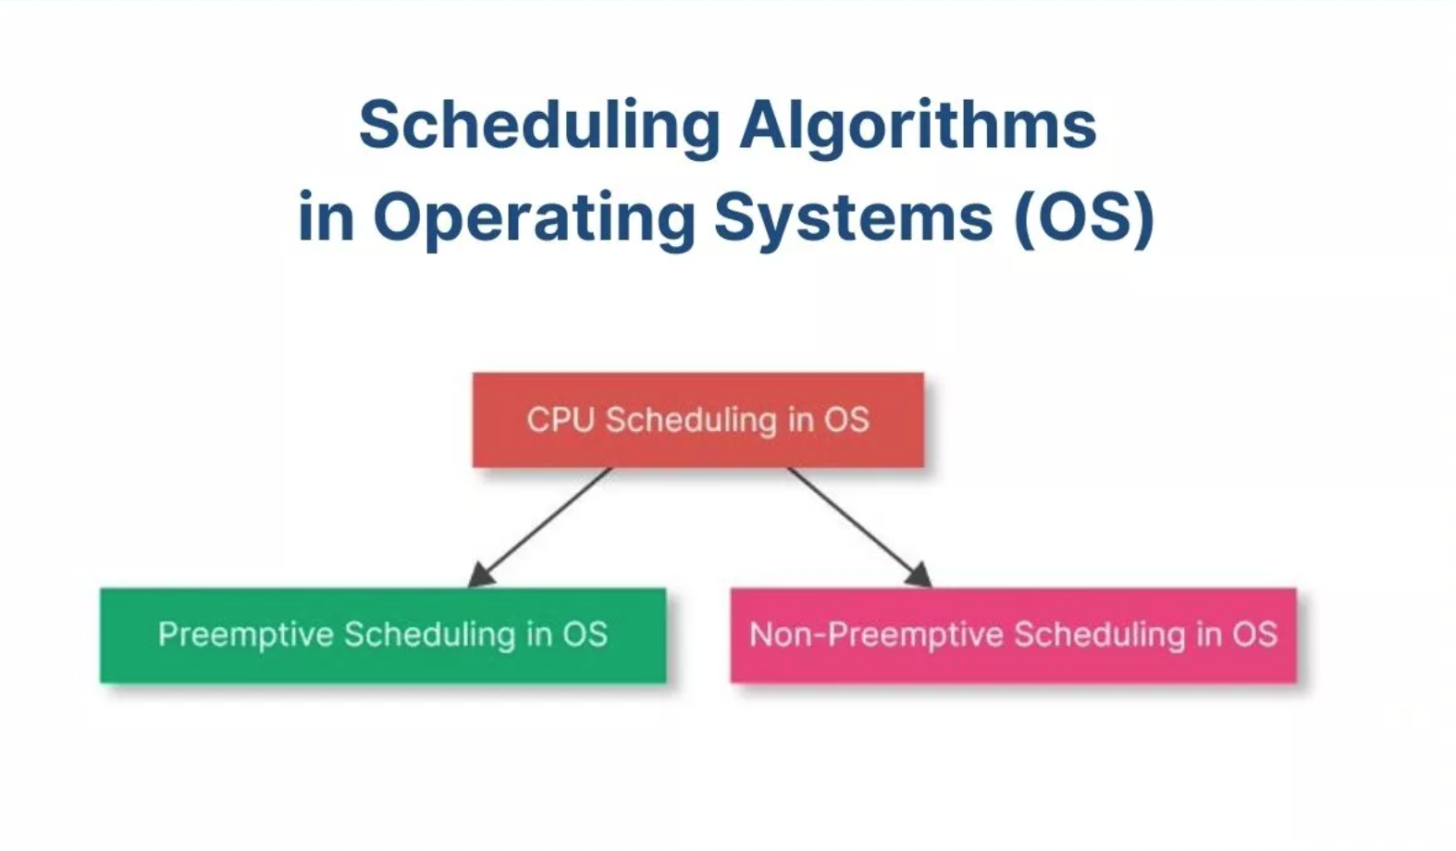

Slide 63
What is a Process in Programming?
In computer programming, a process refers to a program that is being executed in that instance.
Ideally, a program does nothing until and unless a CPU executes the program instructions.
In short, we can say that a process is a program in execution.

Slide 64
What is Process Scheduling in OS?
Process scheduling is the activity of deciding which process should be performed first (or when), based on a particular strategy/ algorithm.
This activity is performed by the process manager; as it removes an active process from the CPU and selects another from the queue.
The need for scheduling in OS arises since most applications are multi-programing, i.e. they allow for multiple processes to be loaded and shared with the CPU at a point in time.
The manager needs to make the decision on which of these processes must be performed first.

Slide 65
Continue
The three major process scheduler types are as follows:
Long-term job scheduler
Medium-term scheduler
CPU or short-term scheduler

Slide 66
Continue
Another component of process scheduling is the process queues. All the programs and processes in the system are split up into queues as follows:
Job queue- All the programs in the system stay in this queue before they are up for execution.
Ready queue- The programs that are ready to be executed remain in this queue; just before they are picked up for execution.
Device queue- This queue consists of the processes that have been blocked due to a lack of input/output (I/O) device.

Slide 67
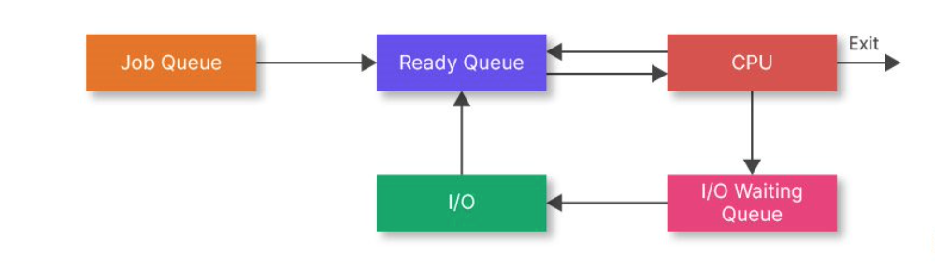

Slide 68
The Need for Process Scheduling in OS
As mentioned before, there are numerous programs in the operating system (OS) that are in queue for execution at any given point in time.
The OS must launch these programs, then stop them, and switch to another program for smooth functioning.
A process scheduler is needed to help the OS ascertain which program to run, and when to stop and switch.

Slide 69
The Need for Process Scheduling in OS
Scheduling allows the OS to allocate CPU time for each process depending upon a pre-decided strategy/ algorithm.
Process scheduling also helps the CPU to stay busy at all times thus making sure that the OS utilizes CPU time to the optimum.
This in effect minimizes time wastage and also that the time a program has to wait to be executed is as short as possible.
It is needed to ensure that the turnaround time for a process to complete execution is minimized.
It also reduces or minimizes the response time for the programs.

Slide 70
What is CPU Scheduling Algorithm?
A scheduling algorithm in OS is the algorithm that defines how much CPU time must be allotted to which process and when. There are two types of scheduling algorithms:
Non-preemptive scheduling algorithms- For these algorithms, once a process starts running, they are not stopped until completion. That is, under non-preemptive algorithms, processes cannot be pre-empted in favor of other high-priority processes before their runtime is over.
Preemptive scheduling algorithms- These algorithms allow for low-priority processes to be preempted in favor of a high-priority process even if they haven’t run to completion.

Slide 71
The objectives of these process scheduling algorithms are
Maximize CPU utilization
Maximize throughput (i.e. number of processes to complete execution per unit time)
Minimize wait, turnaround, and response time

Slide 72
Different Types of CPU Scheduling Algorithms

Slide 73
1. First Come First Serve (FCFS) Scheduling Algorithm
The FCFS algorithm is the simplest of scheduling algorithms in OS.
This is because the deciding principle behind it is just as its name suggests- on a first come basis.
The job that requests execution first gets the CPU allocated to it, then the second, and so on.

Slide 74
Characteristics of FCFS scheduling algorithm
The algorithm is easy to understand and implement.
Programs are executed on a first come first serve basis.
It is a non-preemptive scheduling algorithm.
In this case, the ready queue acts as the First In First Out (FIFO) queue - Where the job that gets ready for execution first, also gets out first.
This is used in most batch OS.

Slide 75
Advantages of FCFS scheduling algorithm
The fact that it is simple to implement means it can easily be integrated into a pre-existing system.
It is especially useful when the processes have a large burst time since there is no need for context switching.
The absence of low or high-priority preferences makes it fairer.
Every process gets its chance to execute.

Slide 76
Disadvantages of the FCFS scheduling algorithm
Since its first come basis, small processes with a very short execution time, have to wait their turn.
There is a high wait and turnaround time for this scheduling algorithm in OS.
All in all, it leads to inefficient utilization of the CPU.

Slide 77
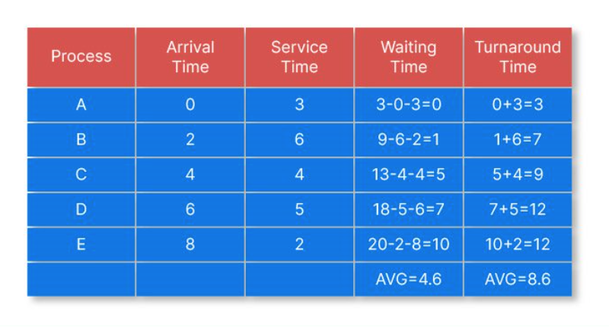
Example of FCFS scheduling algorithm in OS-

Slide 78
2. Shortest Job First (SJF) Scheduling Algorithm
The Shortest Job First (SJF) is a CPU scheduling algorithm that selects the shortest jobs on priority and executes them.
The idea is that jobs with short burst time get done quickly, making CPU available for other, longer jobs/ processes.
In other words, this is a priority scheduling algorithm based on the shortest burst time.

Slide 79
Characteristics of SJF scheduling algorithm
This CPU scheduling algorithm has a minimum average wait time since it prioritizes jobs with the shortest burst time.
If there are multiple short jobs, it may lead to starvation.
This is a non-preemptive scheduling algorithm.
It is easier to implement the SJF algorithm in Batch OS.

Slide 80
Advantages of SJF scheduling algorithm
It minimizes the average waiting time and turnaround time.
Beneficial in long-term scheduling.
Is better than the FCFS scheduling algorithm.
Useful for batch processes.

Slide 81
Disadvantages of the SJF scheduling algorithm
As mentioned if short time jobs keep on coming, it may lead to starvation for longer jobs.
Is dependent upon burst time, but it is not always possible to know the burst time beforehand.
Does not work for interactive systems.

Slide 82
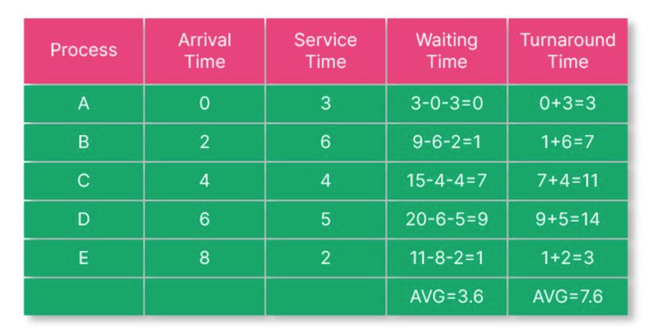
Example of SJF scheduling algorithm in OS-

Slide 83
Priority Scheduling Algorithm in OS
This CPU scheduling algorithm in OS first executes the jobs with higher priority.
That is, the job with the highest priority gets executed first, followed by the second prioritized jobs, and so on.

Slide 84
Characteristics of Priority Scheduling Algorithm
Jobs are scheduled on the basis of the priority level, in descending order.
If a job with higher priority than the one running currently comes on, the CPU preempts the current job in favor of the one with higher priority.
But for other purposes, it follows a non-preemptive scheduling approach.
In between two jobs with the same priority, the FCFS process decides which jobs get executed first.
The priority of a process can be set depending on multiple factors like memory requirements, required CPU time, etc.

Slide 85
Advantages of Priority Scheduling Algorithm
This process is simpler than most other scheduling algorithms in OS.
Priorities help in sorting the incoming processes.
Works well for static and dynamic environments.
Disadvantages of Priority Scheduling Algorithm
It may lead to the starvation problem in jobs with low priority.
The average turnaround and waiting time might be higher in comparison to other CPU scheduling algorithms.

Slide 86
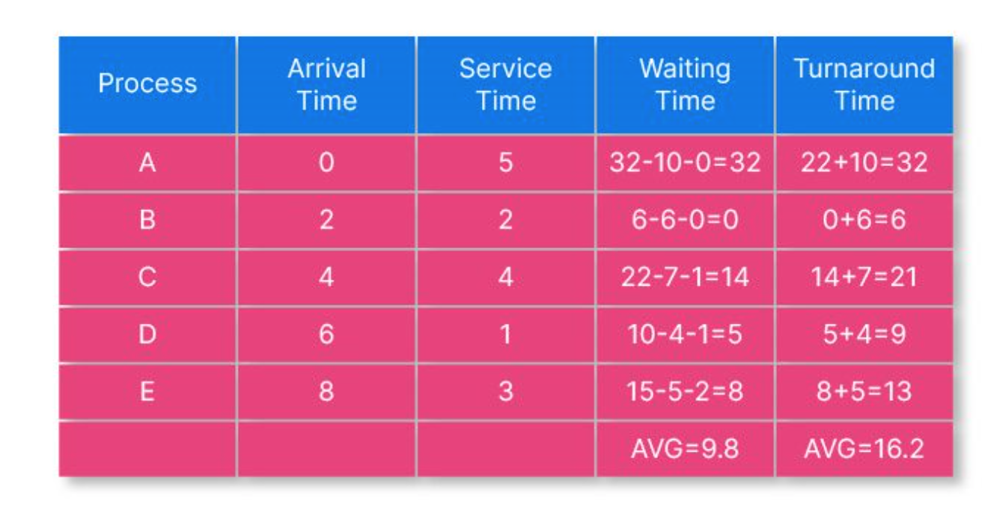
Example of Priority Scheduling Algorithm in OS-

Slide 87
5. Round Robin Scheduling Algorithm in OS
In this scheduling algorithm, the OS defines a quantum time or a fixed time period.
And every job is run cyclically for this predefined period of time, before being preempted for the next job in the ready queue.
The jobs that are preempted before completion go back to the ready queue to wait their turn.
It is also referred to as the preemptive version of the FCFS scheduling algorithm in OS.

Slide 88
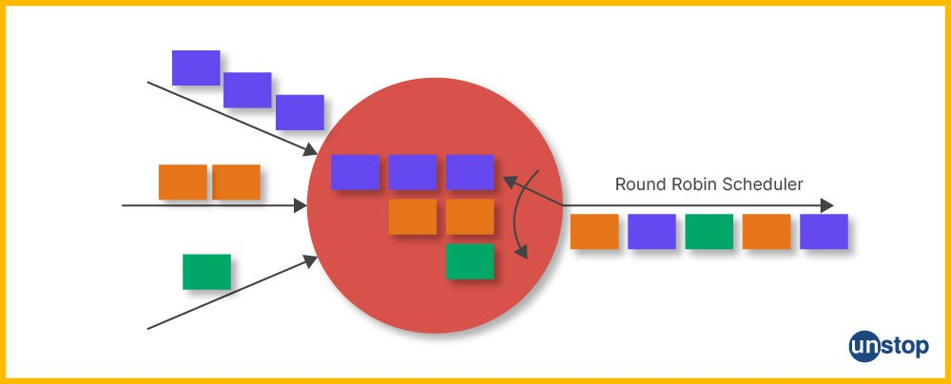
As seen from the figure, the scheduler executes the 3 incoming processes part by part.

Slide 89
Characteristics of RR Scheduling Algorithm
Once a job begins running, it is executed for a predetermined time and gets preempted after the time quantum is over.
It is easy and simple to use or implement.
The RR scheduling algorithm is one of the most commonly used CPU scheduling algorithms in OS.
It is a preemptive algorithm.

Slide 90
Advantages of RR Scheduling Algorithm
This seems like a fair algorithm since all jobs get equal time CPU.
Does not lead to any starvation problems.
New jobs are added at the end of the ready queue and do not interrupt the ongoing process.
Leads to efficient utilization of the CPU.

Slide 91
Disadvantages of RR Scheduling Algorithm
Every time job runs the course of quantum time, a context switch happens. This adds to the overhead time, and ultimately the overall execution time.
A low slicing time may lead to low CPU output.
Important tasks aren’t given priority.
Choosing the correct time quantum is a difficult job.

Slide 92
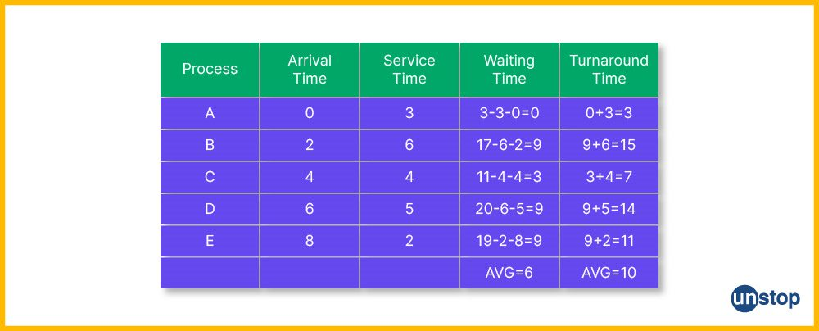
Example of RR Scheduling Algorithm in OS-

Slide 93
8. Highest Response Ratio Next (HRRN) Scheduling Algorithm
The HRRN scheduling algorithm calls for the calculation of the response ratio of all the jobs/ processes. It then selects the job with the highest response ratio to execute on a priority basis. The response ratio (RR) is calculated as follows:
Response Ratio = (W+B)/ B
where, W is the waiting time, and B is the burst time/ service time.

Slide 94
Characteristics of HRRN Scheduling Algorithm
The HRRN algorithm selects the job with the highest response ratio and puts it up for execution.
Once this job is executed, all the jobs are again put in the read queue to calculate wait time, and then the response ratio is calculated again. And so on.
In case two jobs have the same response ratio, the FCFS method is used to select which is put to execution, first.
This is a non-preemptive algorithm, that is, once a job is put to execution the next response ratio is not calculated until the job completes the execution process.

Slide 95
Advantages of HRRN Scheduling Algorithm
This is more efficient than SJF scheduling.
The throughput for this algorithm is high or at least more than many other scheduling algorithms in OS.
While on the one hand, the waiting time for longer jobs is lesser, on the other it encourages the execution of shorter jobs.

Slide 96
Disadvantages of HRRN Scheduling Algorithm
It is not the most implemented algorithm since we cannot always know the burst time for every job beforehand.
Processor overhead may occur.

Slide 97
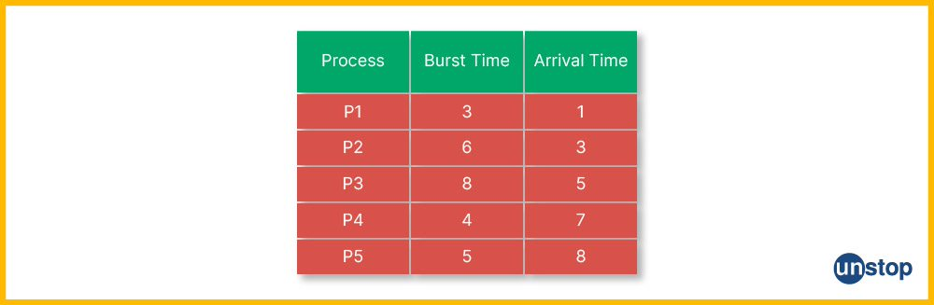

Example of HRRN scheduling algorithm in OS-

Slide 98
Multilevel queue scheduling

Slide 99
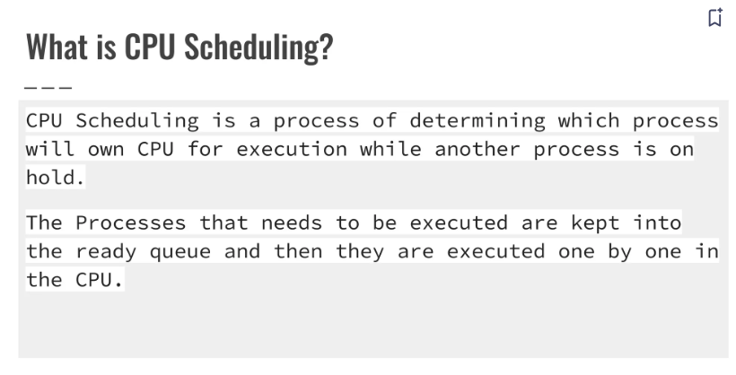

Slide 100
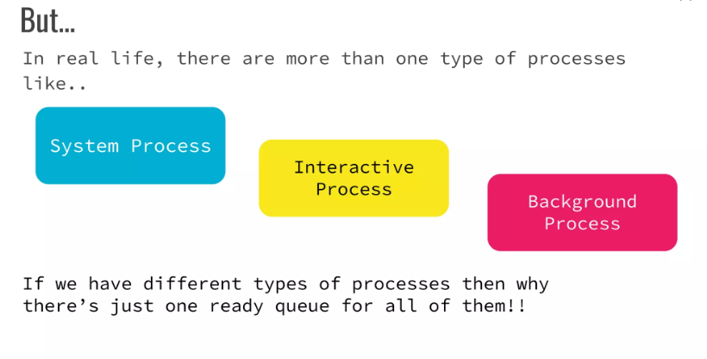

Slide 101
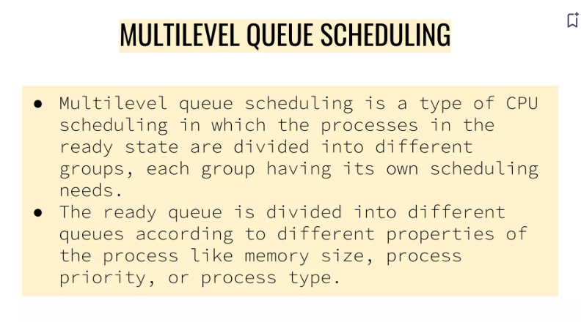

Slide 102
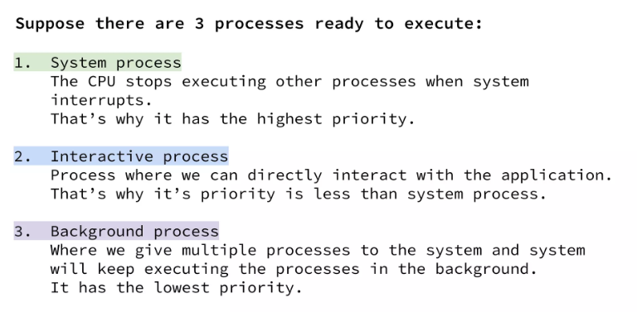

Slide 103
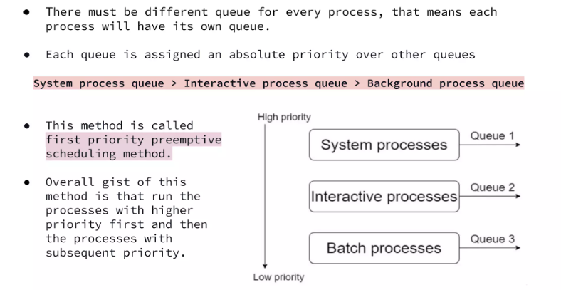

Slide 104
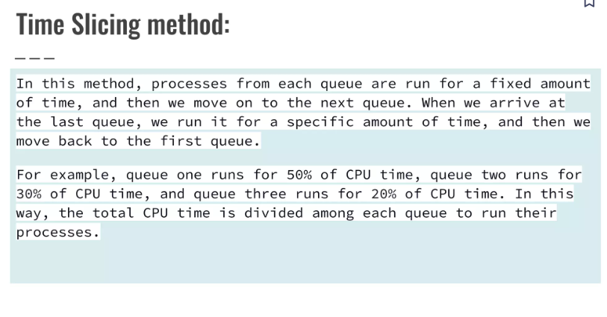

Slide 105
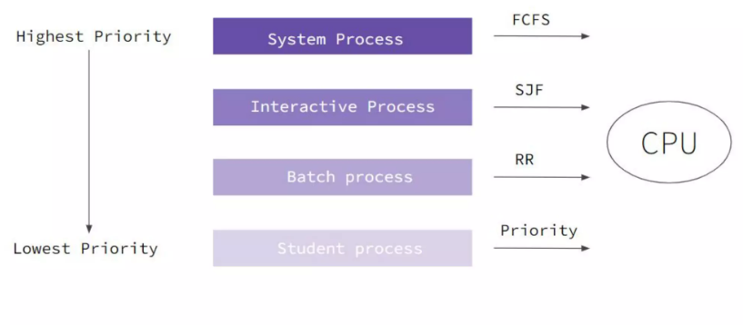

Slide 106
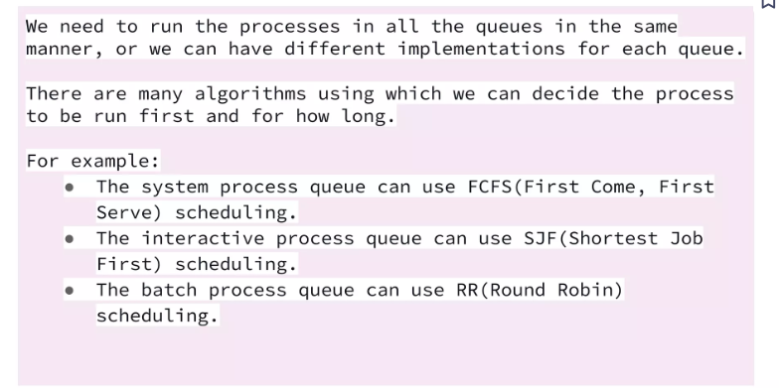

Slide 107
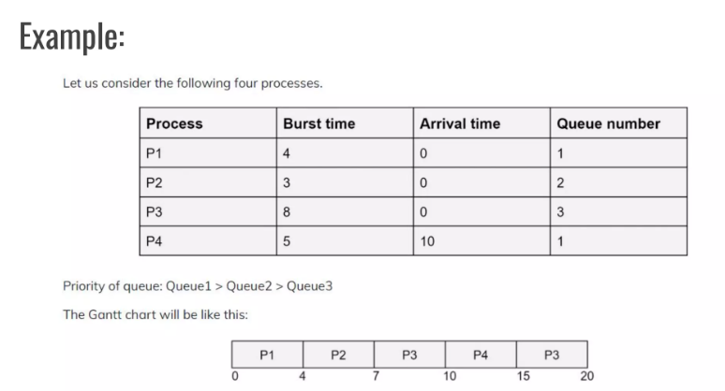

Slide 108
